Slide 1

File System
Computer System Principles, Fall 2020 (IPADS, SJTU)
Yubin Xia

Slide 2
File System Basic

Slide 3
The Big Picture
User
App-1
App-2
App-3
OPEN("a.txt", "rw")
READ(…)
WRITE(…)
…
File System
Kernel
Disk Driver
READ(block-addr, buf)
WRITE(block-addr, buf)
Hardware
Memory
Disk

Slide 4
Abstraction: API of UNIX File System
OPEN, READ, WRITE, SEEK, CLOSE
FSYNC
STAT, CHMOD, CHOWN
RENAME, LINK, UNLINK, SYMLINK
MKDIR, CHDIR, CHROOT
MOUNT, UNMOUNT
….

Slide 5
inode Structure
block
indirect block
double indirect block
inode
Notes:
with a 512 byte block size, and 4 byte block pointers, each indirect block can consist of 128 (512 / 4) pointers.
For one double indirect block: (128*128*512) / (1024*1024)

Slide 6
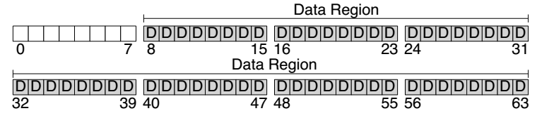
Disk Layout of a Simple File System

Slide 7
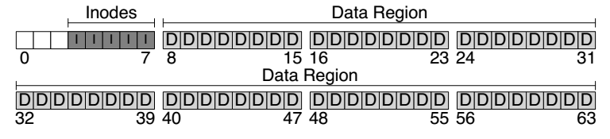
At the Head of a Disk Partition
S
i
d
i: inode free block bitmap
d: data free block bitmap
S: super-block
How many inodes: 80
How many data blocks: 56
Where the inode table begins: block 3
…
The magic number to identify the file system type
The super-block is used when
the file system is mounted

Slide 8
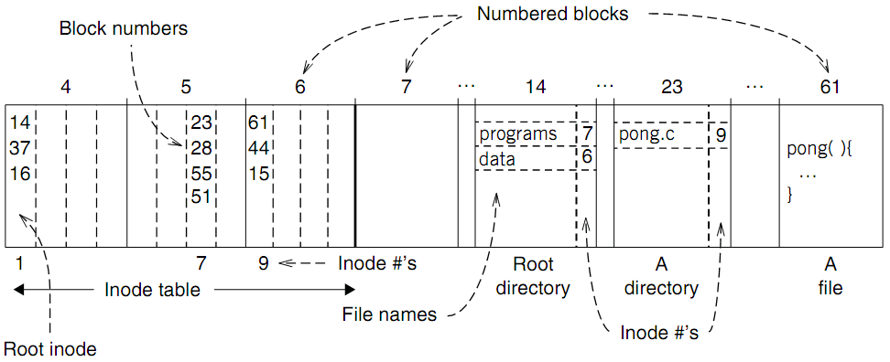
An example: find blocks of “/programs/pong.c”

Slide 9
An example: find blocks of “/programs/pong.c”
‘/’ root directory: inode is 1

Slide 10
An example: find blocks of “/programs/pong.c”
Find the first directory in ‘/’ by block number

Slide 11
An example: find blocks of “/programs/pong.c”
Find ‘/programs’ by comparing name

Slide 12
An example: find blocks of “/programs/pong.c”
Find ‘/programs’ inode by its inode number 7

Slide 13
An example: find blocks of “/programs/pong.c”
Find the first file in ‘/programs/’

Slide 14
An example: find blocks of “/programs/pong.c”
Find ‘/programs/pong.c’ by comparing its name

Slide 15
An example: find blocks of “/programs/pong.c”
Find inode of ‘/programs/pong.c’ by the inode number 9

Slide 16
An example: find blocks of “/programs/pong.c”
Find block number of ‘/programs/pong.c’

Slide 17
An example: find blocks of “/programs/pong.c”
Find data of block 61 by its block number
And data of block 44 & 15

Slide 18
Directly Dump a Directory
$ ls -ai temp
7536909 . 7530417 .. 7536939 a 7536940 b 7536941 c 7536942 d
$ echo “obase=16;7536909;7530417;7536939;7536940;7536941;7536942" | bc
73010D 72E7B1 73012B 73012C 73012D 73012E
$ sudo /sbin/debugfs /dev/sda1
debugfs 1.43.4 (31-Jan-2017)
debugfs: dump temp temp.out
debugfs: quit
$ xxd temp.out
0000000: 0d01 7300 0c00 0102 2e00 0000 b1e7 7200 ..s...........r.
0000010: 0c00 0202 2e2e 0000 2b01 7300 0c00 0101 ........+.s.....
0000020: 6100 0000 2c01 7300 0c00 0101 6200 0000 a...,.s.....b...
0000030: 2d01 7300 0c00 0101 6300 0000 2e01 7300 -.s.....c.....s.
0000040: c40f 0101 6400 0000 0000 0000 0000 0000 ....d...........
0000050: ...

Slide 19
Directly Dump a Directory
struct ext4_dir_entry {
uint32_t inode_number;
uint16_t dir_entry_length;
uint8_t file_name_length;
uint8_t file_type;
char name[EXT4_NAME_LEN];
}
0d01 7300 0c00 0102 2e00 0000
b1e7 7200 0c00 0202 2e2e 0000
2b01 7300 0c00 0101 6100 0000
2c01 7300 0c00 0101 6200 0000
2d01 7300 0c00 0101 6300 0000
2e01 7300 c40f 0101 6400 0000
File Type
0x0: Unknown
0x1: Regular file
0x2: Directory
0x3: Character device file
0x4: Block device file
0x5: FIFO
0x6: Socket
0x7: Symbolic link
0d01 7300 0c00 0102 2e00 0000
0d01 7300: inode number
0c00: entry length is 12 bytes
01: file name length is 1 byte
01: file type is regular file
2e00 0000: file name (2e -> ".")

Slide 20
Two Types of Links (Synonyms)
Add link "assignment" to "Mail/new-assignment"
Hard link
No new file is created
Just add a binding between a string and an existing inode
Target inode reference count is increased
If target file is deleted, the link is still valid
Soft link
A new file is created, the data is the string "Mail/new-assignment"
Target inode reference count is not increased
If target file is deleted, the link is not valid
Soft link can create cycle by SYMLINK("a", "a")
Notes:
Here comes a demo~

Slide 21
Directly Dump a Symbolic Link
$ ln -s "/tmp/abc" s-link
$ ls –l s-link
7536945 lrwxrwxrwx 1 xiayubin 8 Sep 20 08:01 s-link -> /tmp/abc
$ readlink s-link
/tmp/abc
$ cat s-link
cat: slink: No such file or directory
$ echo "hello, world" > /tmp/abc
$ cat s-link
hello, world
What does "8" means?
File size

Slide 22
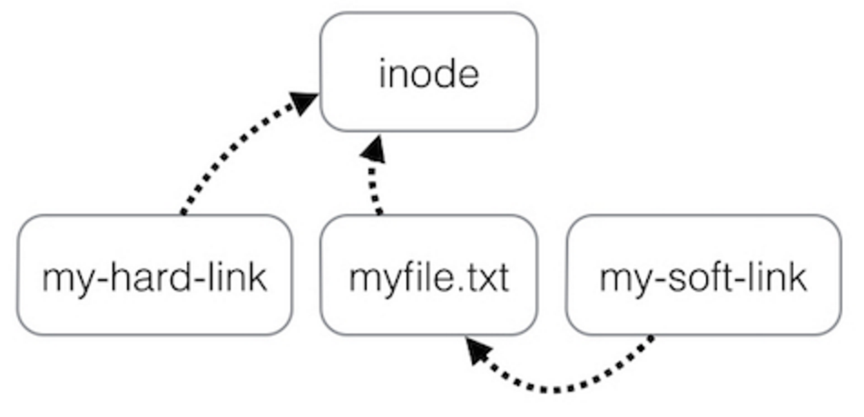
Two Types of Links (Synonyms)
By inode number
By inode number
By file name

Slide 23
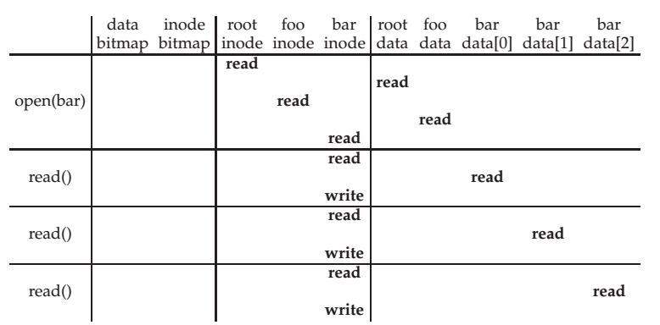
File Open & Read Timeline
open("/foo/bar", O_RDONLY)

Slide 24
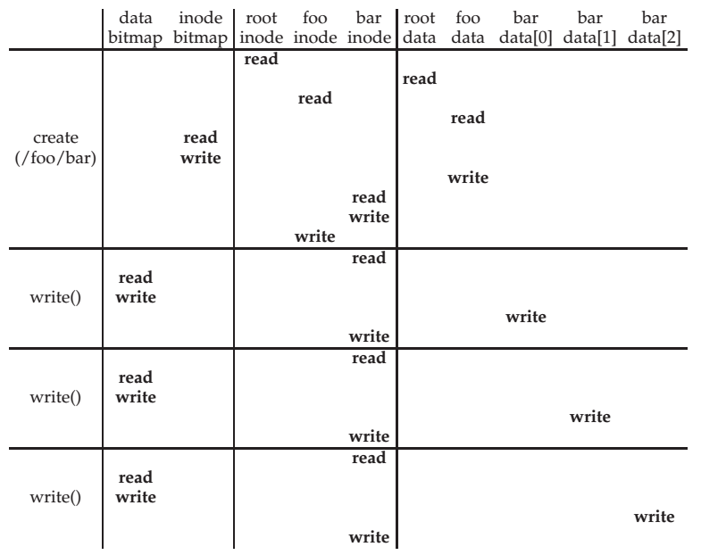
File Creation Timeline

Slide 25
FAT (File Allocation Table) File System
File is collection of disk blocks
FAT is linked list 1-1 with blocks
File Number is index of root of block list for the file
File offset (o = < B, x > )
Follow list to get block #
Unused blocks ⬄ FAT free list
FAT
Disk Blocks
file number
0:
0:
31:
File 31, Block 0
File 31, Block 1
free
File 31, Block 2
N-1:
N-1:
memory

Slide 26
FAT Properties
File is collection of disk blocks
FAT is linked list 1-1 with blocks
File Number is index of root of block list for the file
File offset (o = < B, x > )
Follow list to get block #
Unused blocks ⬄ FAT free list
Ex: file_write(31, < 3, y >)
Grab blocks from free list
Linking them into file
FAT
Disk Blocks
file number
0:
0:
31:
File 31, Block 0
File 31, Block 1
File 31, Block 3
free
File 31, Block 2
N-1:
N-1:
memory

Slide 27
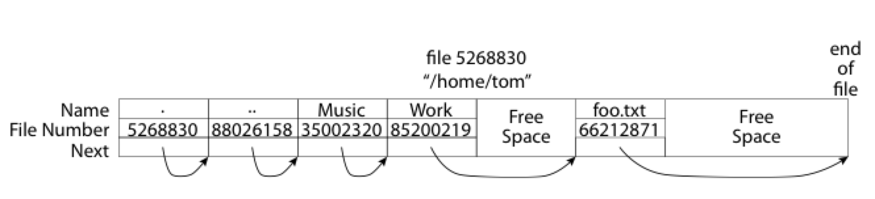
What about the Directory in FAT?
Essentially a file containing <file_name: file_number> mappings
Free space for new entries
In FAT: file attributes are kept in directory (!!!)
Each directory a linked list of entries
Q: Where to find root directory ( "/" )?

Slide 28
FS Crash Consistency

Slide 29
Crash Consistency Problem
Single file-system operation updates multiple on-disk data structures
System may crash in middle of updates
File-system is partially (incorrectly) updated

Slide 30
File System Durability
Topic: tension between fs perf. and crash recovery
Disk performance is often a #1 bottleneck
"how many seeks will that take?”
Durability != Crash consistency
“Here is all of my data. But some of the metadata is wrong.”
Crash recovery is much harder than performance
"what if a crash occurred at this point?”

Slide 31
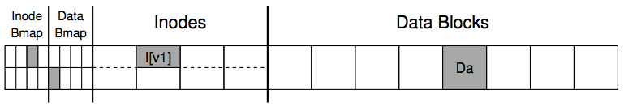
An Example: Append a File
Inside of I[v1]:
owner : yubin
permissions : read-only
size : 1
pointer : 4
pointer : null
pointer : null
pointer : null

Slide 32
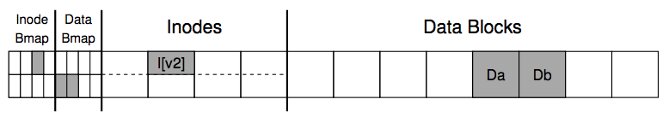
An Example: Append a File
Inside of I[v2]:
owner : yubin
permissions : read-only
size : 2
pointer : 4
pointer : 5
pointer : null
pointer : null

Slide 33
Crash Scenarios: 1 Succeeds
Imagine only a single write succeeds; there are thus three possible outcomes:
1. Just the data block (Db) is written to disk
What will happen?
2. Just the updated inode (I[v2]) is written to disk
What will happen?
3. Just the updated bitmap (B[v2]) is written to disk
What will happen?
Notes:
1. In this case, the data is on disk, but there is no inode that points to it and no bitmap that even says the block is allocated. Thus, it is as if the write never occurred. This case is not a problem at all, from the perspective of file-system crash consistency.
2. File system inconsistency!
3. Space leakage

Slide 34
Crash Scenarios: 2 Succeed
Two writes succeed and the last one fails:
1. The inode (I[v2]) and bitmap (B[v2]) are written to disk, but not data (Db)
2. The inode (I[v2]) and the data block (Db) are written, but not the bitmap (B[v2])
3. The bitmap (B[v2]) and data block (Db) are written, but not the inode (I[v2])
Notes:
Metadata is ok, but data is garbage
Metadata inconsistency!
Block leakage. No idea which inode the block belongs to.

Slide 35
Recovery Approach
Synchronous meta-data update + fsck
Used in xv6-rev0
During check, synchronize meta-data, such as file size
Soft update (FreeBSD fs modified on FFS)
Soft update, not covered in this course
Logging (ext 3/4), xv6-rev6 and following versions
Before doing actual meta-data update, log the event
After crash, recover from log

Slide 36
Sync Metadata Update + fsck

Slide 37
Typical Set of Tradeoffs
FS ensures it can recover its meta-data
Internal consistency
No dangling references
Inode and block free list contain only used (not using) items
Unique name in one directory, etc.
Weak semantic FS provided limited guarantees
Atomicity for creat, rename, delete
Often no durability for anything
(creat("a"), then crash, no a)
Often no order guarantees

Slide 38
What does fsck do?
1. Check superblock
E.g., making sure the file system size is greater than the number of blocks allocated
If error, use an alternate copy of the superblock
2. Check free blocks
Scans the inodes, indirect blocks, double indirect blocks, etc.
Uses this knowledge to produce a correct version of the allocation bitmaps
Same for the inode bitmap

Slide 39
What does fsck do?
3. Check inode states
Check type: regular file, dir, symbolic link, etc.
Clear suspect inodes and clear the inode bitmap
4. Check inode links
Check link count by scanning the entire fs tree
If count mismatches, fix the inode
If inode is allocated but no dir contains it, lost+found
5. Check duplicates
Two inodes refer to the same block
If one inode is obviously bad, clear it; otherwise, copy the block and give each a copy

Slide 40
What does fsck do?
6. Check bad blocks
E.g., point to some out-of-range address
What should fsck do? Just remove the pointer
7. Check directories
The only file that fsck know more semantic
Making sure that "." and ".." are the first entries
Ensure no dir is linked more than once
No same filename in one dir

Slide 41

Problem of fsck: Too Slow
How long would fsck take?
an example server: fsck takes 10 minutes per 70GB disk w/ 2 million inodes
clearly reading many inodes sequentially, not seeking
still a long time, probably linear in disk size
Consider the example before:
Scan the disk for only three disk block writes
Just like find a key by searching the entire house

Slide 42
What's the right order of synchronous writes?
File creation
1. mark inode as allocated
2. create directory entry
File deletion
1. erase directory entry
2. erase inode addrs[], mark as free
3. mark blocks free

Slide 43
What about app-visible syscall semantics?
Durable? Yes
Use write-through cache, sync I/O, O_SYNC
Atomic? Often
Mkdir is an exception
Ordered? Yes
If all writes are sync

Slide 44
Issues with Synchronous Write
Main issue
Very slow during normal operation
Very slow during recovery

Slide 45
Ordinary perf. of sync meta-data update?
Creating a file and writing a few bytes
Takes 8 writes, probably 80 ms
(ialloc, init inode, write dirent, alloc data block, add to inode, write data, set length in inode, xxx)
Can create only about a dozen small files per second!
Think about un-tar or rm *

Slide 46
How to get better performance?
Reality:
RAM is cheap
Disk sequential throughput is high, 50 MB/sec
Why not use a big write-back disk cache?
No sync meta-data update operations
Only modify in-memory disk cache (no disk write)
So creat(), unlink(), write() &c return almost immediately
If cache is full, write LRU dirty block
Write all dirty blocks every 30 seconds, to limit loss if crash
This is how old Linux EXT2 file system worked

Slide 47
Write-back Cache
Would write-back cache improve performance?
Why performance would be improved?
After all, you have to write the disk in the end anyway
Notes:
Write absorbtion

Slide 48
Barrier: Flush the Disk
Disk's write buffer
Disk will inform the OS the write is complete when it simply has been placed in the disk's memory cache
But the data is not on disk yet! No durability! No order!
One solution: disable the buffer
Another solution: using flush operation
Force the disk to write data to disk media
Aka., disk write barrier
However, disks may not do as they claim…
Some disks just ignore the flush operation to be faster
"the fast almost always beats out the slow, even if it is wrong" --- Kahan

Slide 49
Logging / Journaling

Slide 50
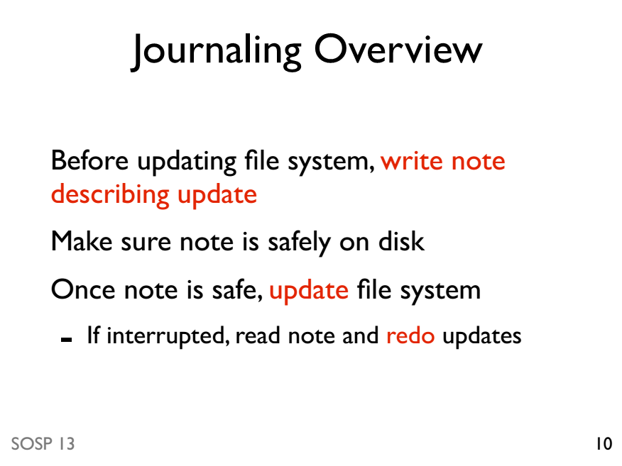

Slide 51
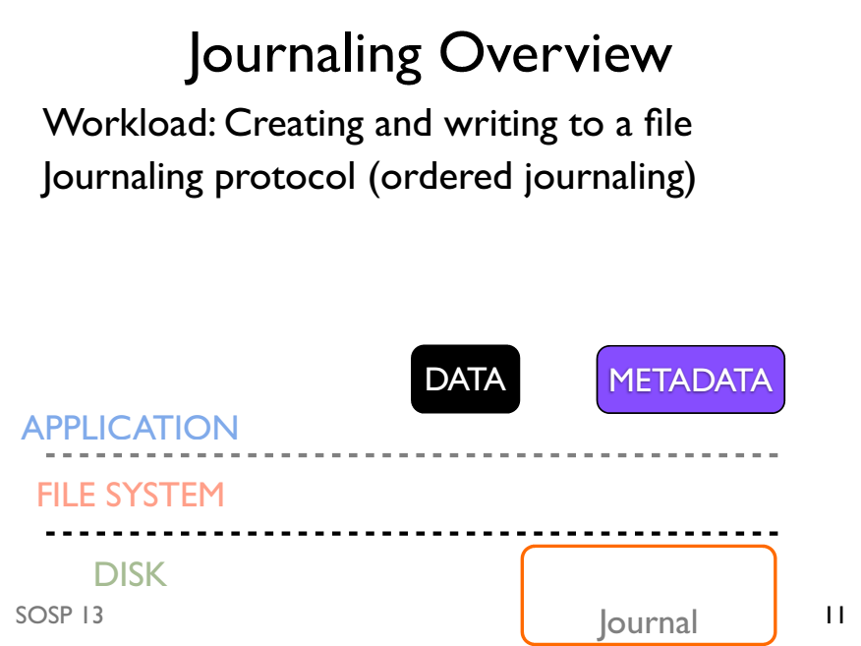

Slide 52
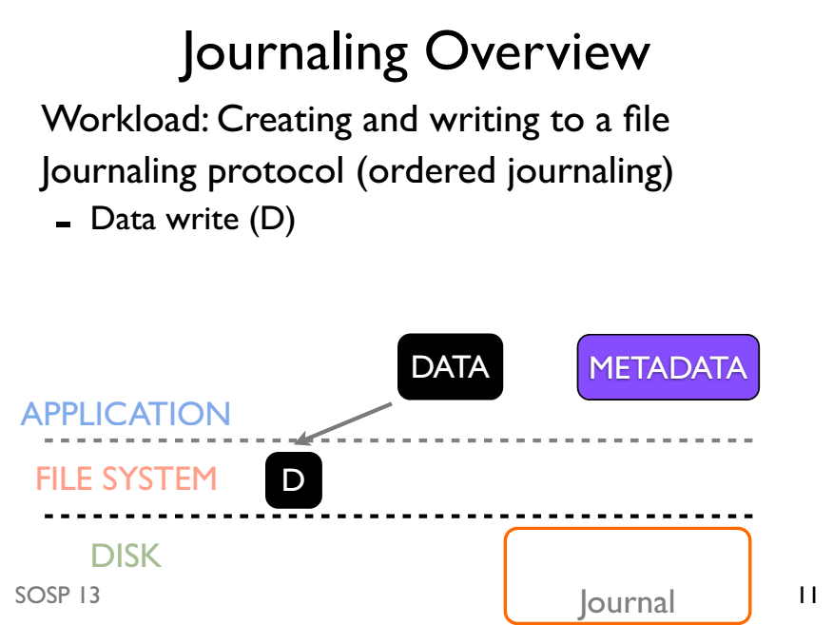

Slide 53
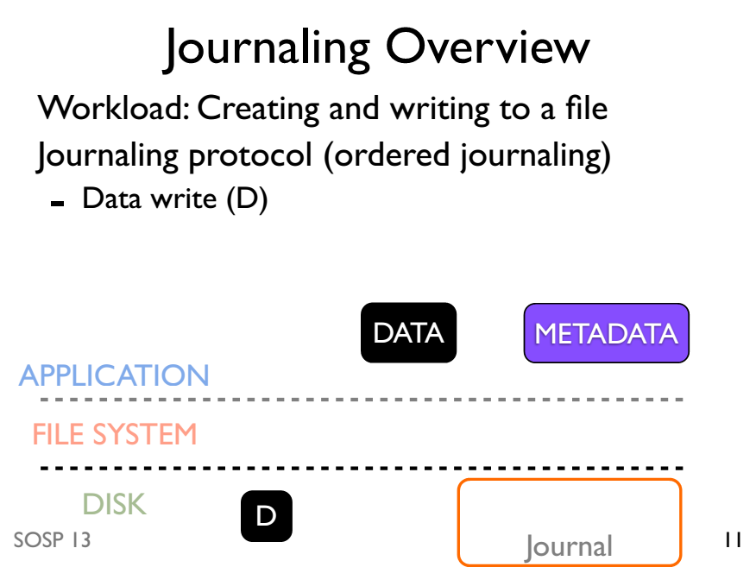

Slide 54
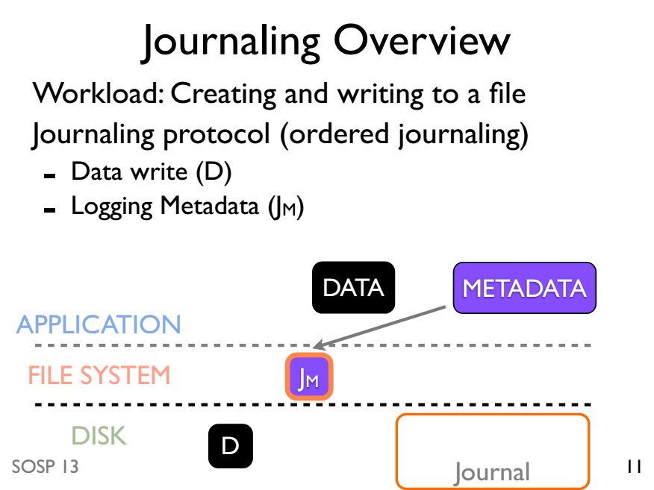

Slide 55
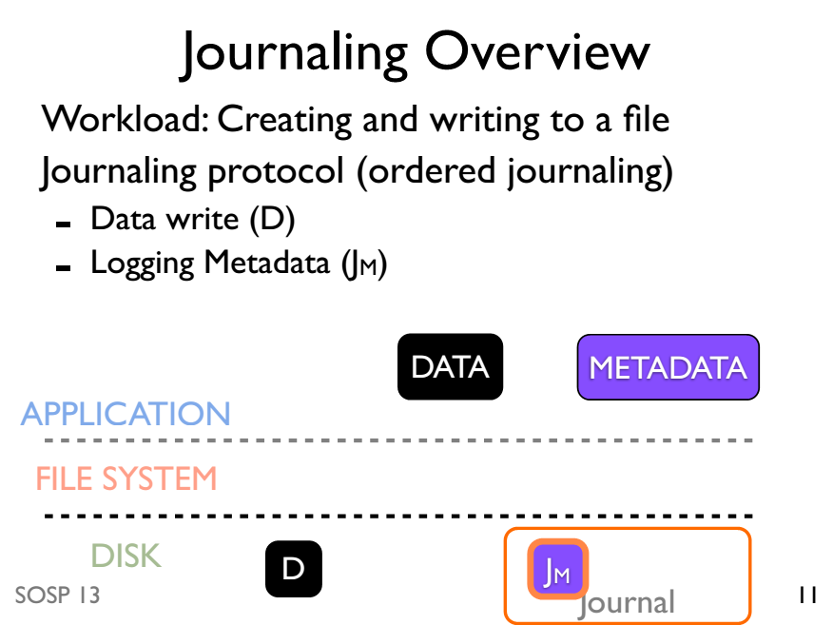

Slide 56
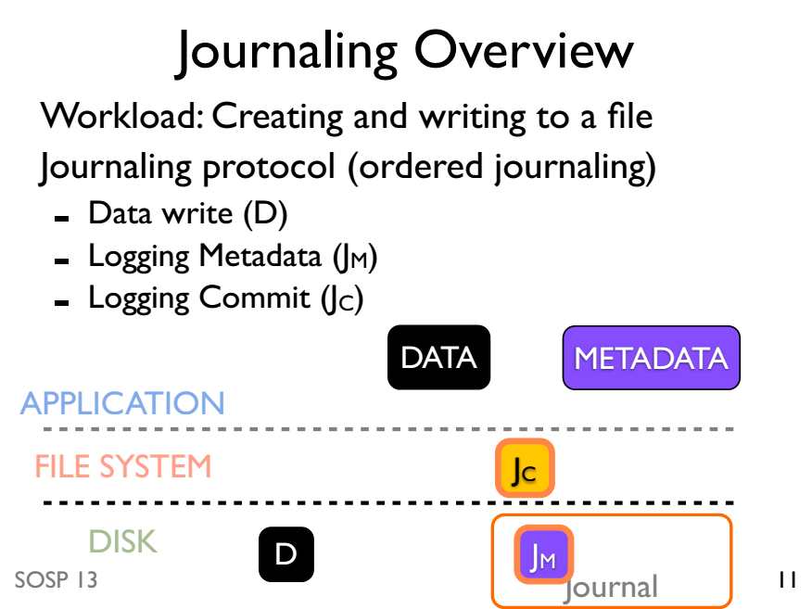

Slide 57
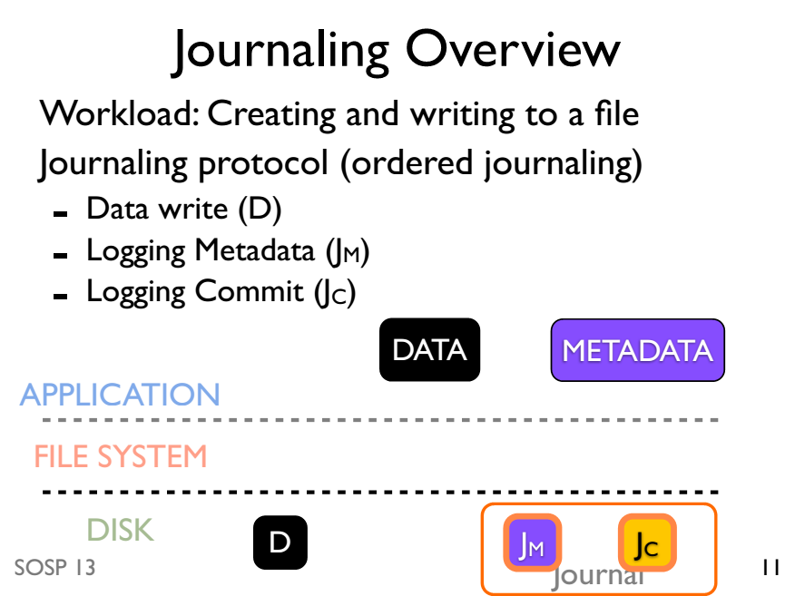

Slide 58
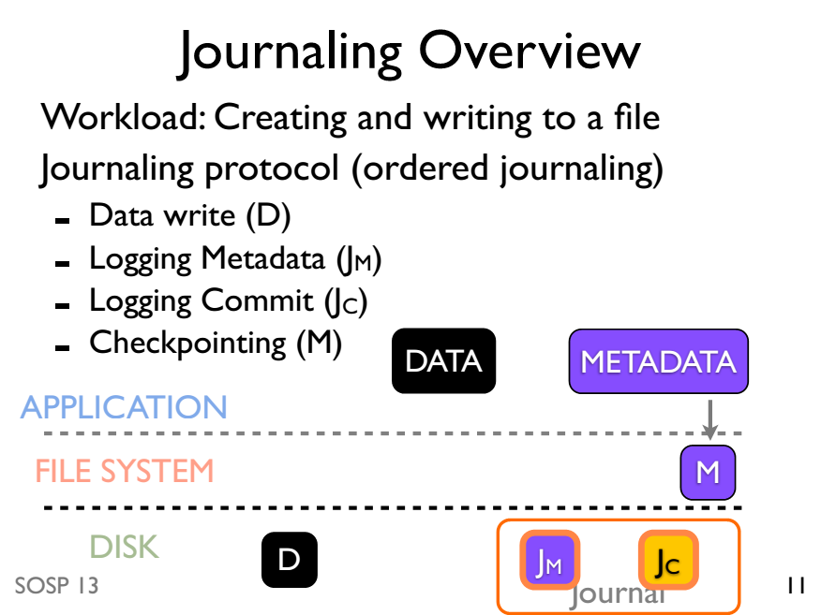

Slide 59
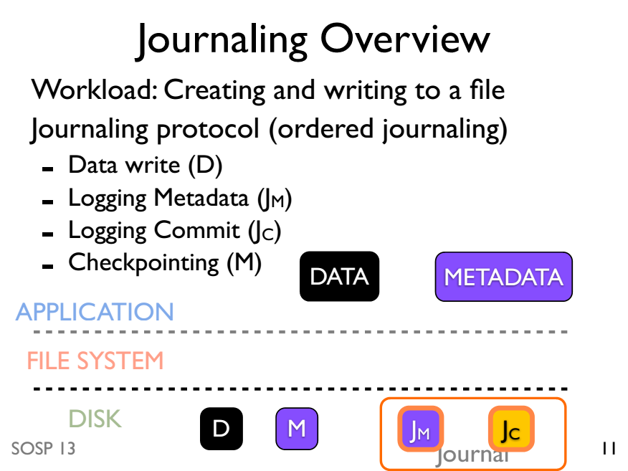

Slide 60
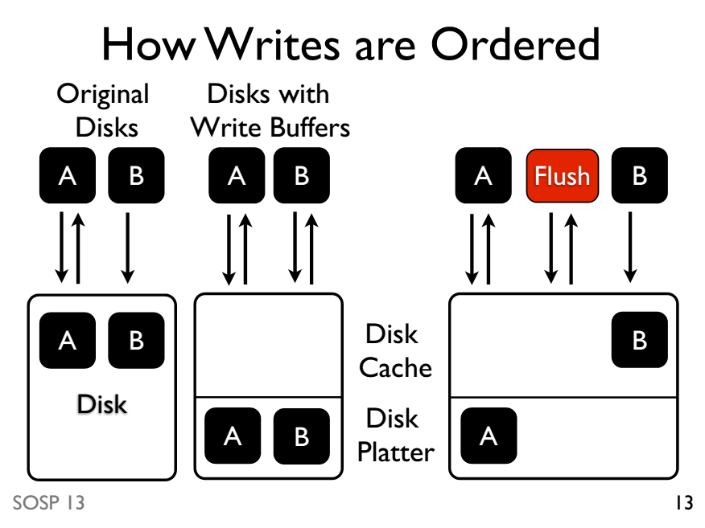

Slide 61
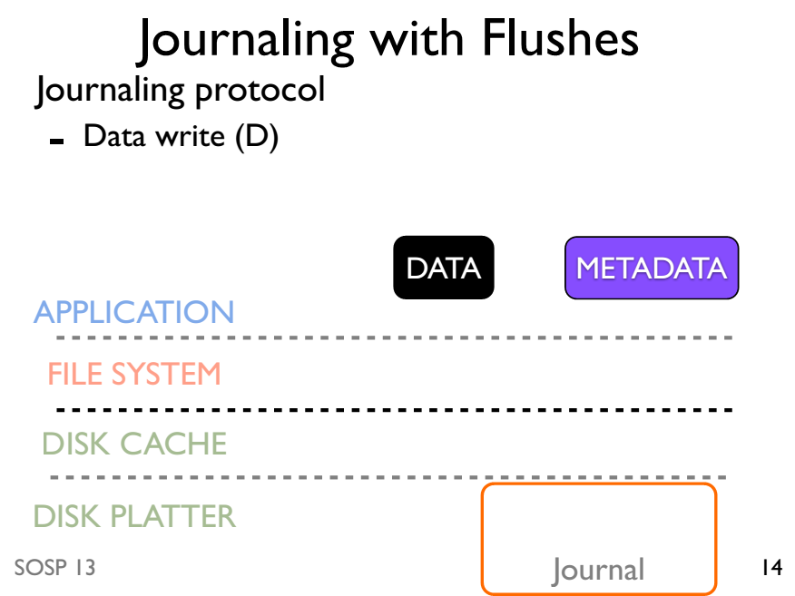

Slide 62
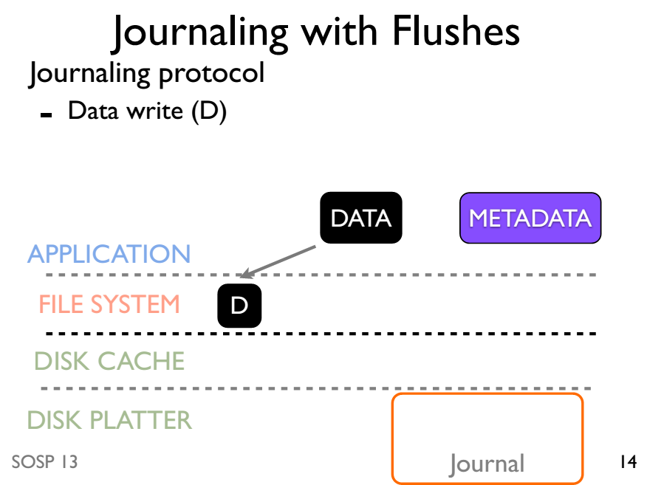

Slide 63
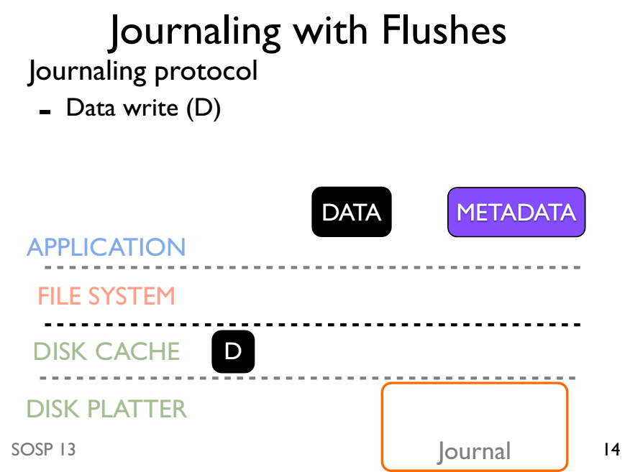

Slide 64
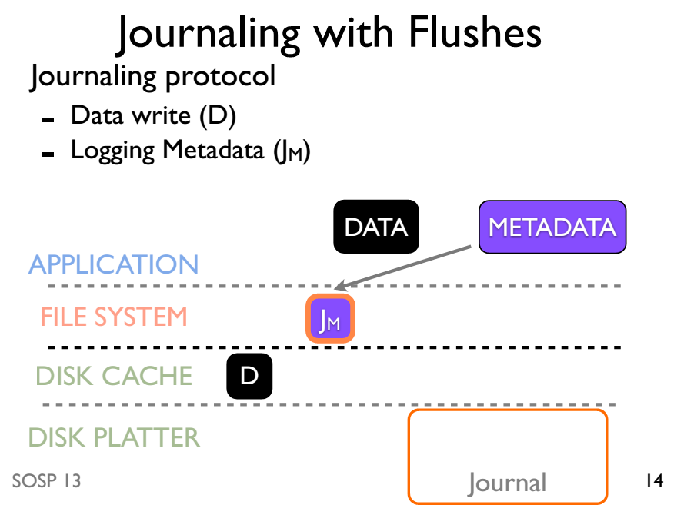

Slide 65
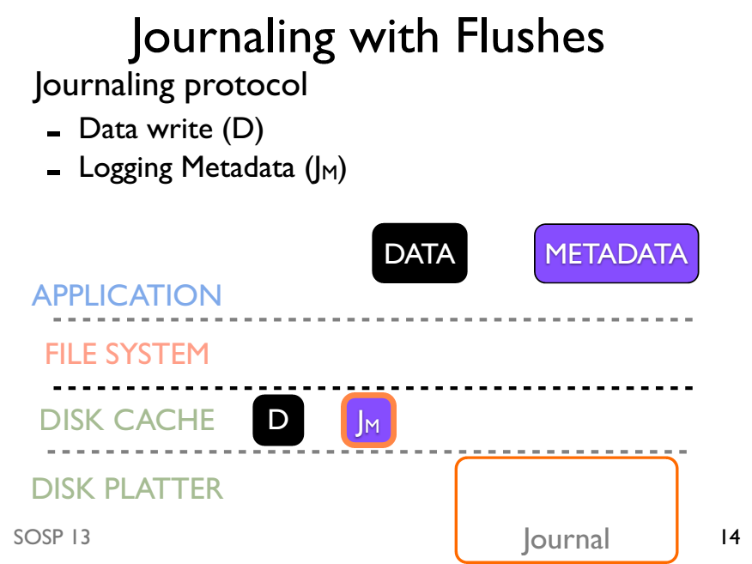

Slide 66
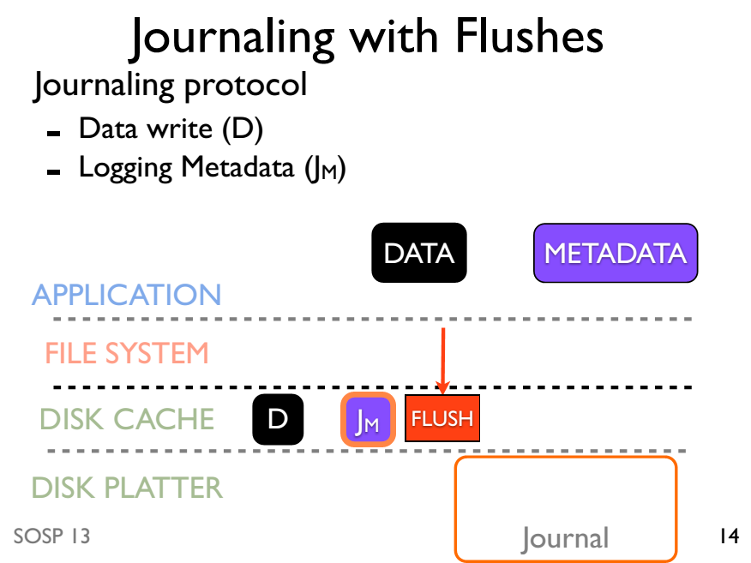

Slide 67
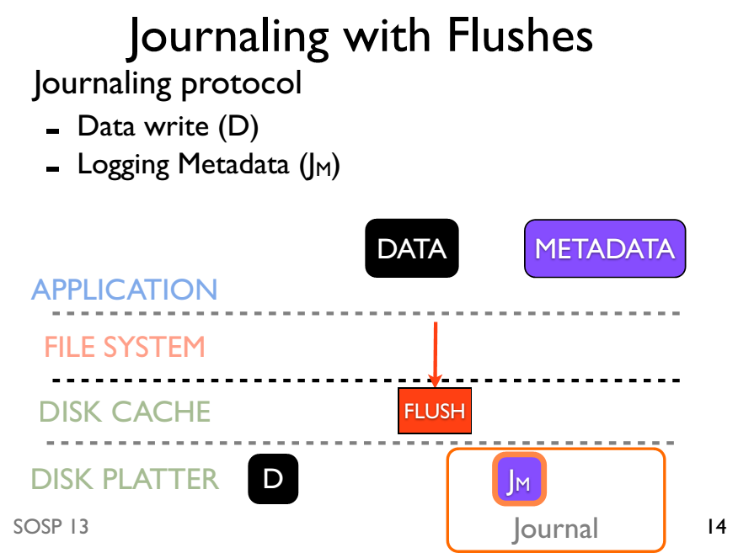

Slide 68
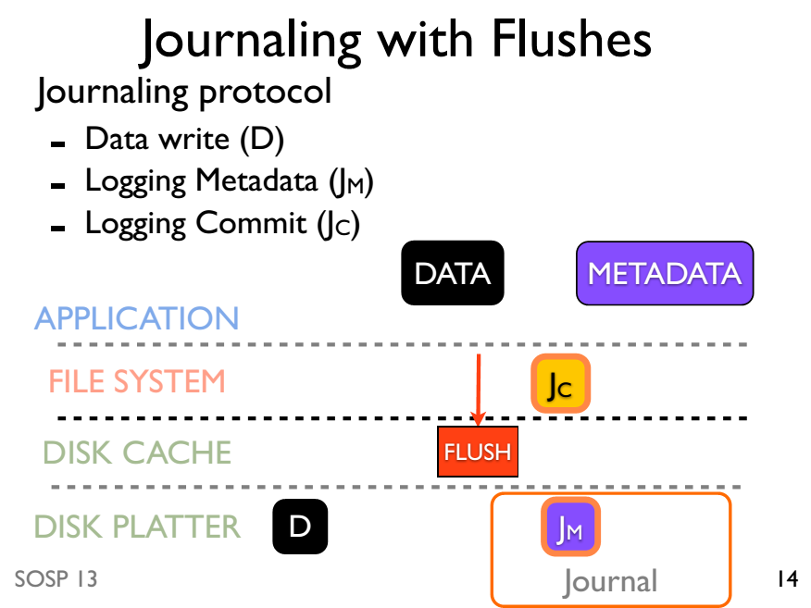

Slide 69
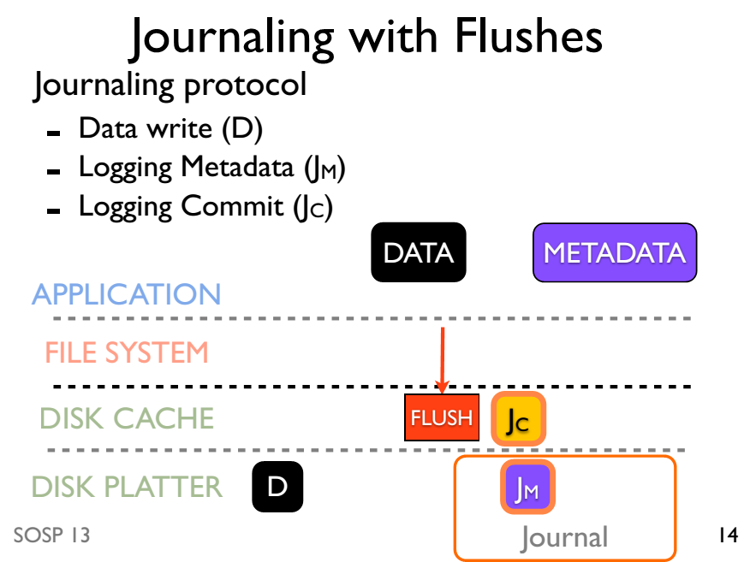

Slide 70
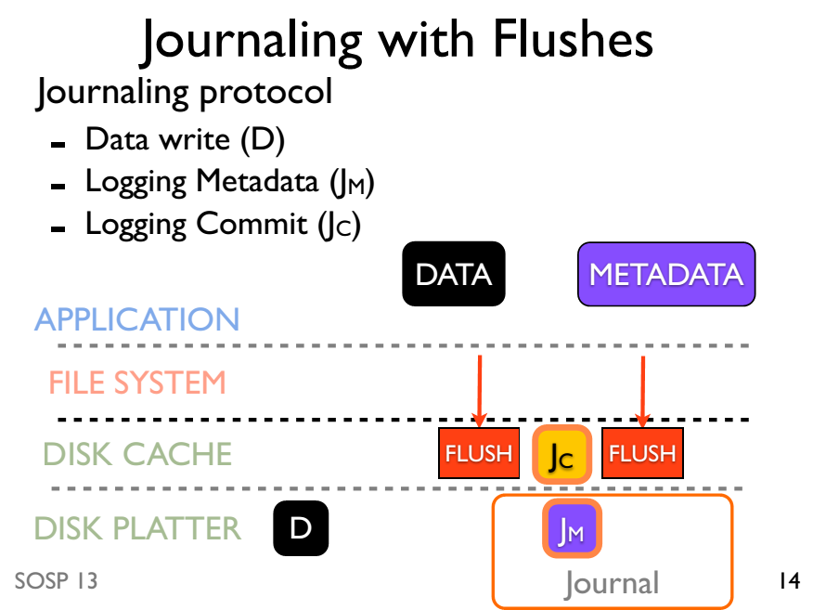

Slide 71
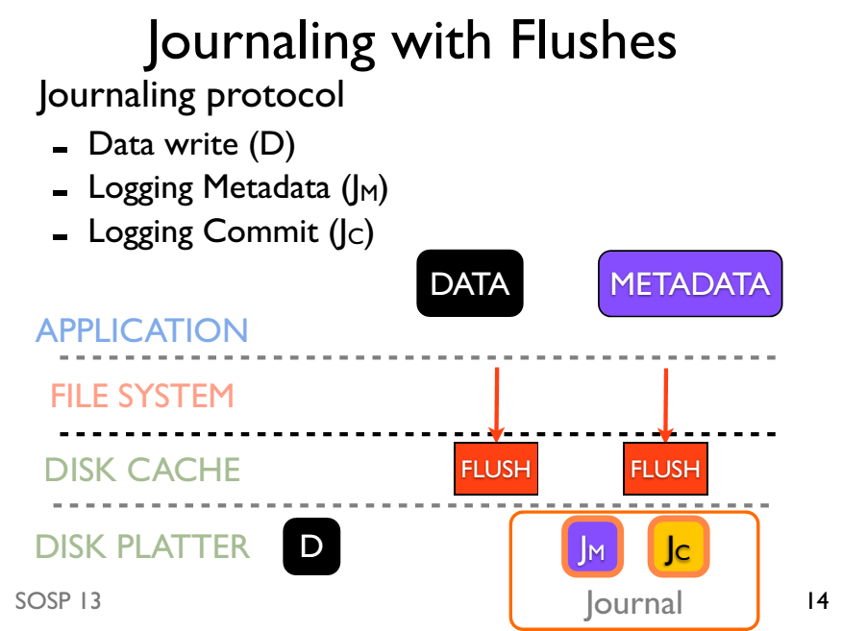

Slide 72
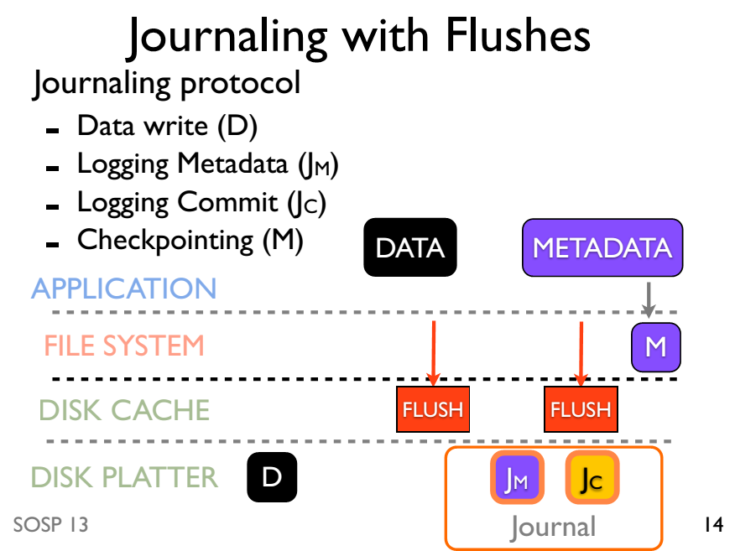

Slide 73
Journaling without ordering

Slide 74
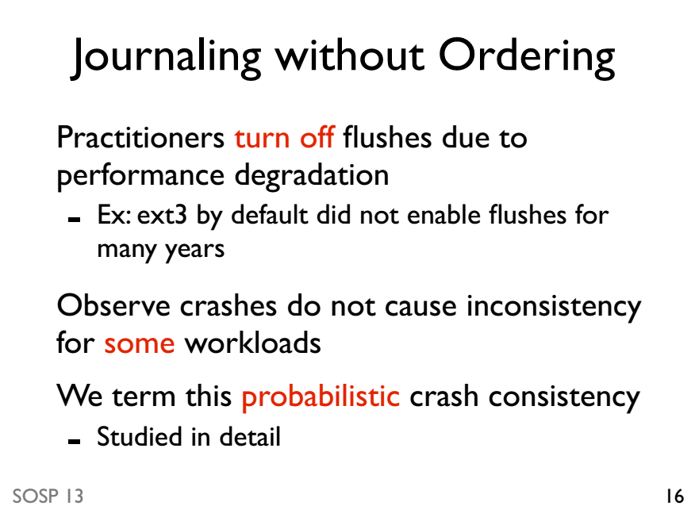

Slide 75
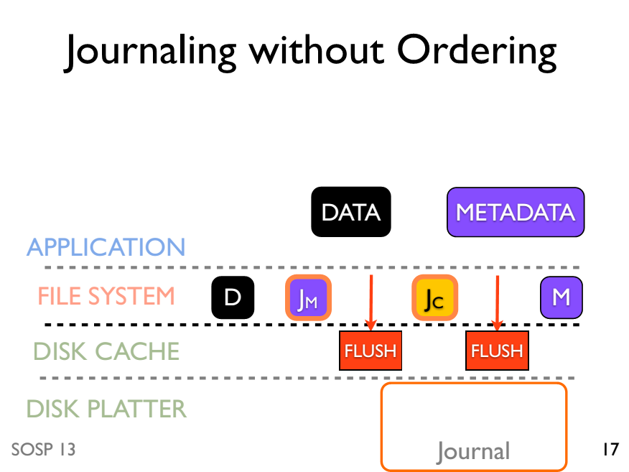

Slide 76
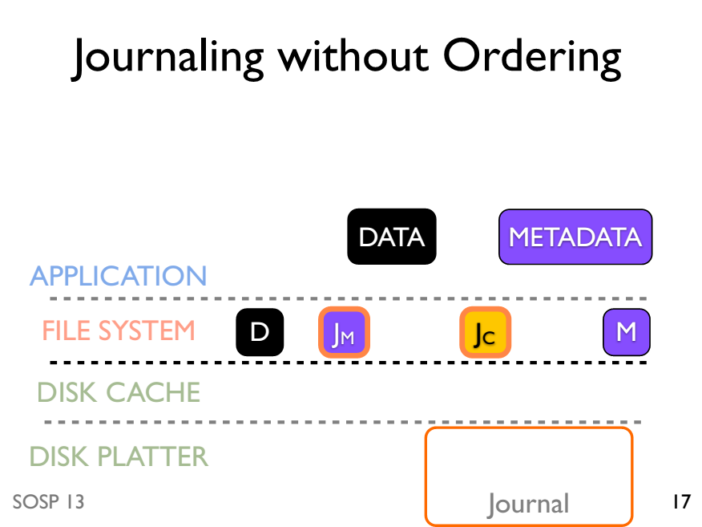

Slide 77
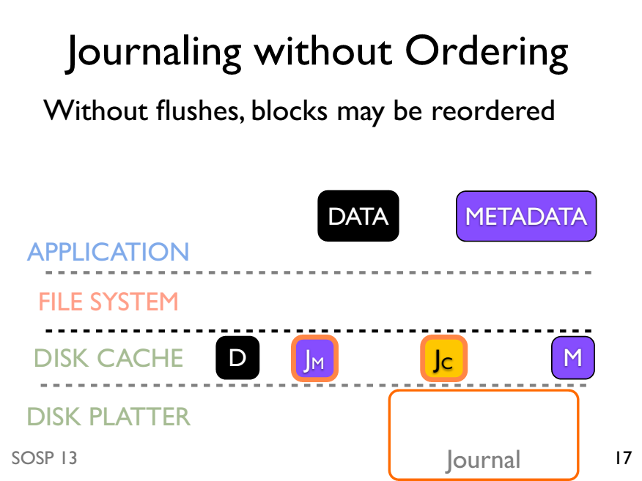

Slide 78
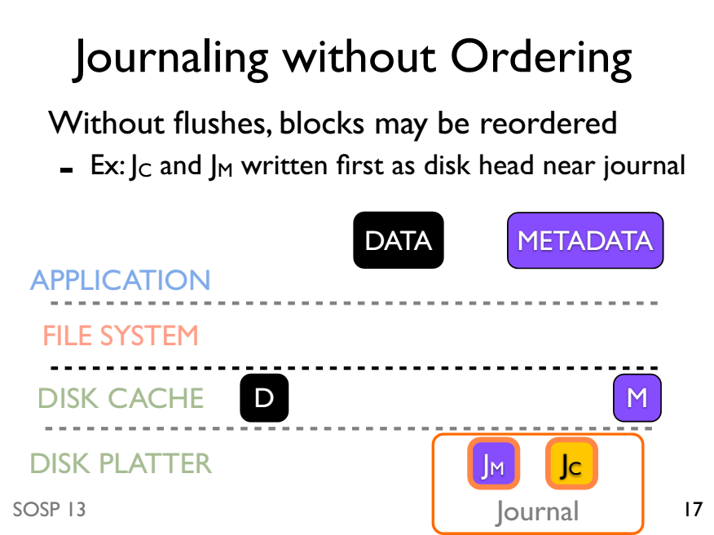

Slide 79
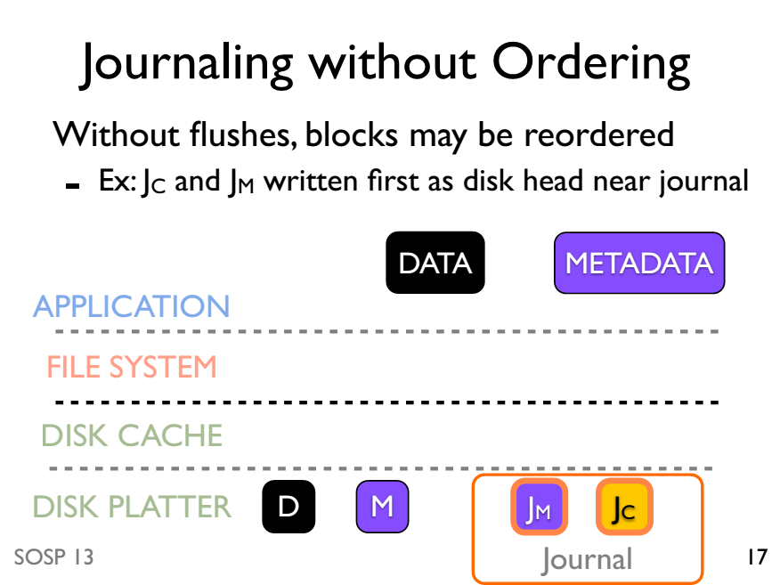

Slide 80
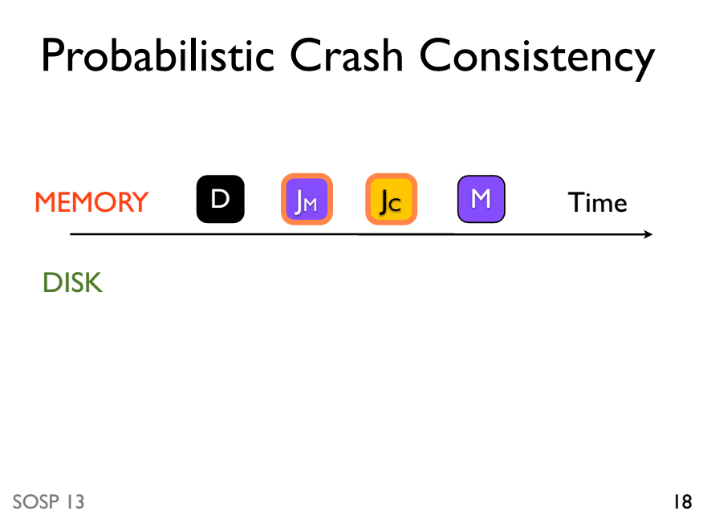

Slide 81
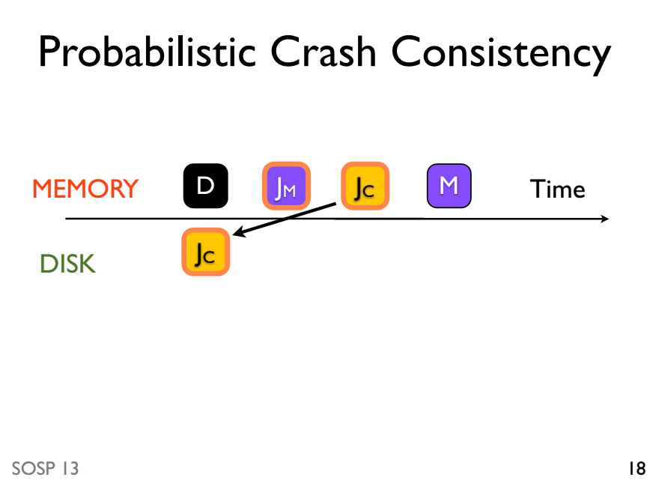

Slide 82
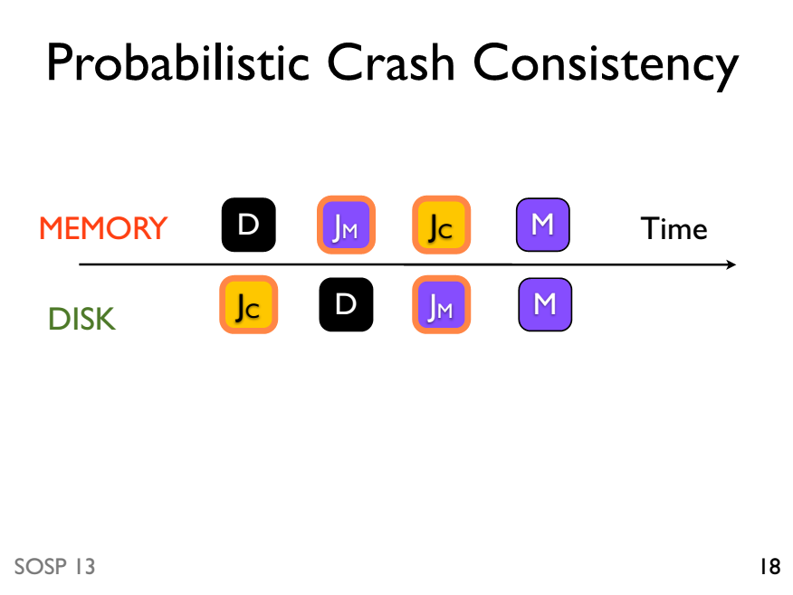

Slide 83
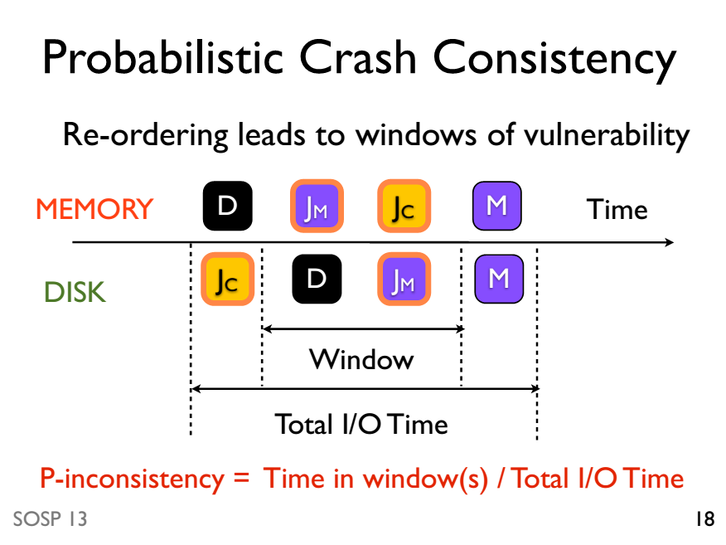

Slide 84
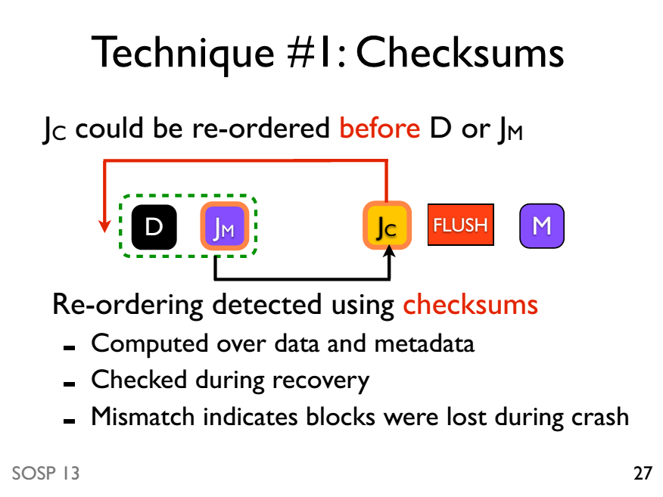

Slide 85
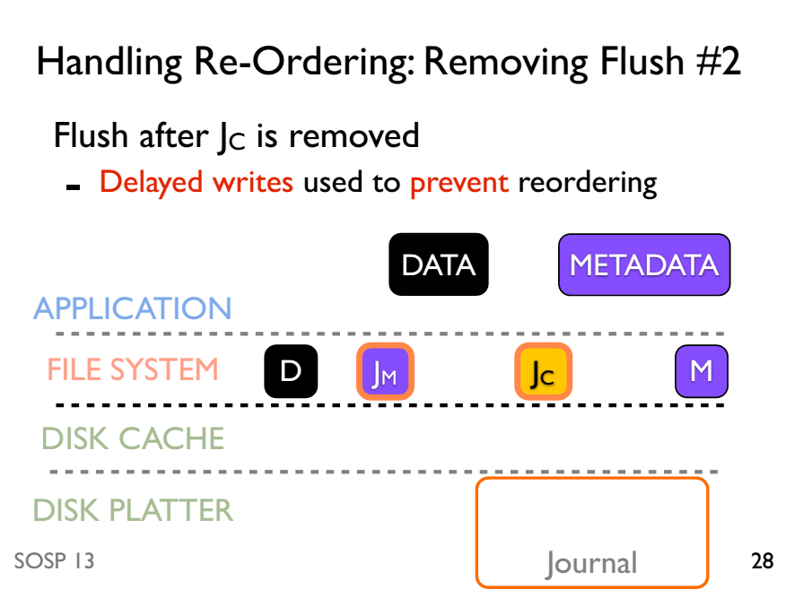

Slide 86
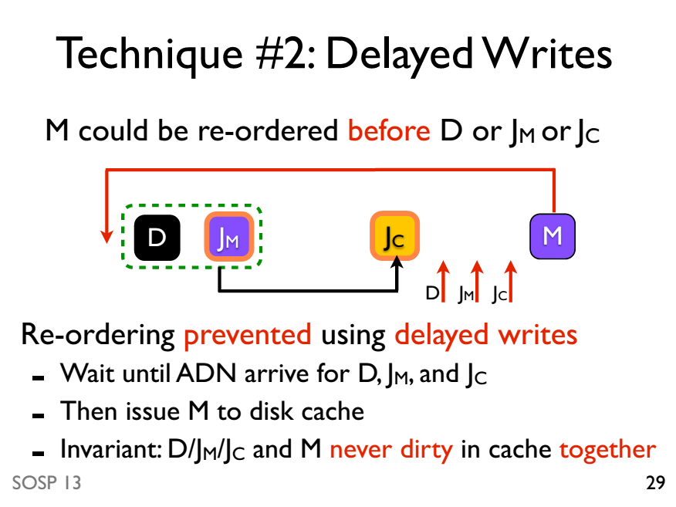

Slide 87
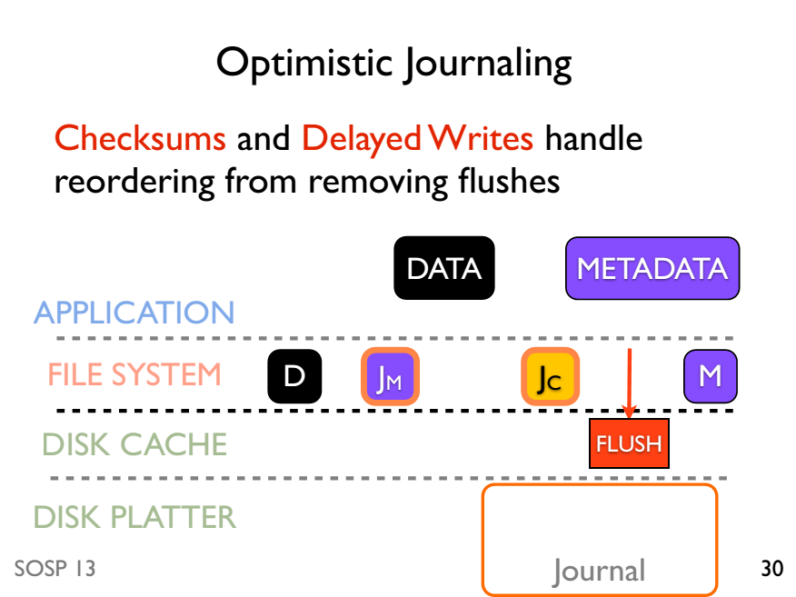

Slide 88
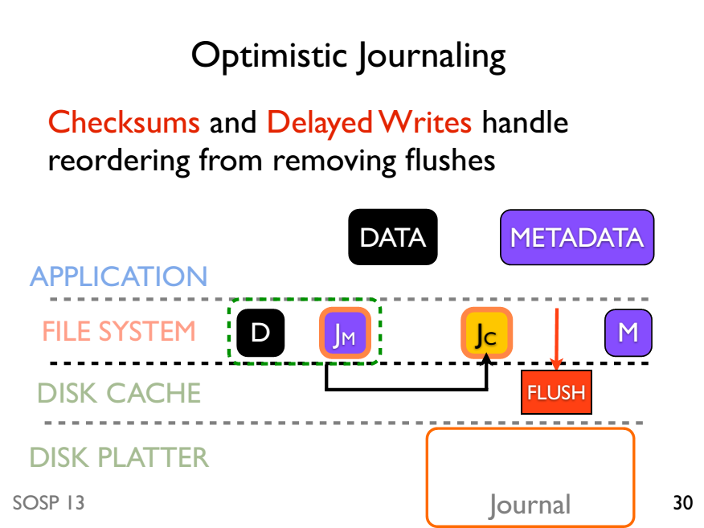

Slide 90
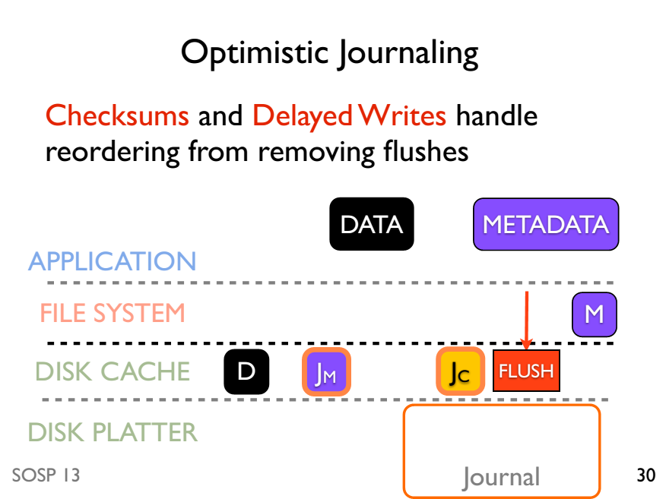

Slide 91
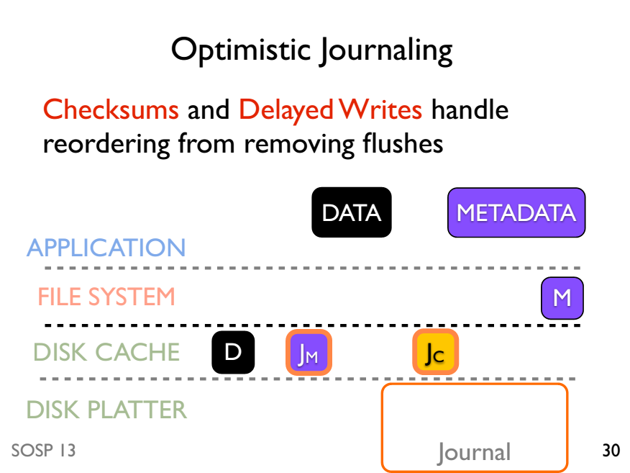

Slide 92
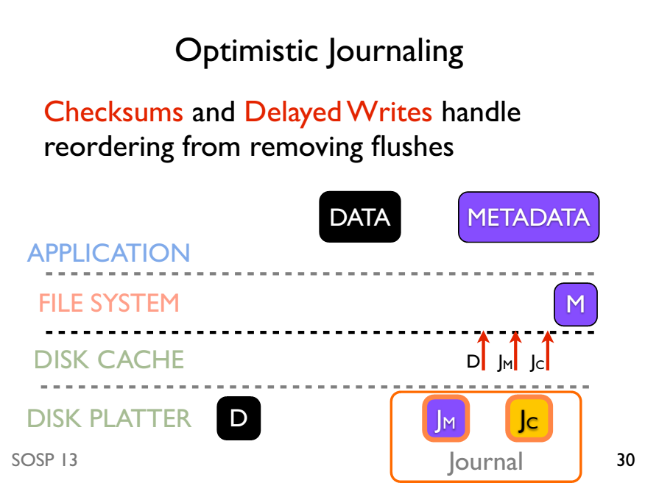

Slide 93


Slide 94
Evaluation
Does OptFS preserve file-system consistency after crashes?
OptFS consistent after 400 random crashes
How does OptFS perform?
OptFS 4-10x better than ext4 with flushes
Can meaningful application-level consistency be built on top of OptFS?
Studied gedit and SQLite on OptFS

